Slide 1
Do-It-Yourself
PTA Membership P.L.A.N.
Presented by National PTA President- Yvonne Johnson
Notes:
[WELCOME & INTRODUCTIONS]
Name, where you are from, how long you have been engaged in PTA, PTA/other positions, etc. (Place in chat if virtual)
[ACTIVITY]
(If in person do this part) Before we talk about growing members. Let’s find out about each other.
If you are a National PTA Leader, clap your hands!
If you are a State PTA Leader, wave your hands in the air!
If you are a District, Council or Region Leader, stomp your feet twice!
If you are a local PTA leader, scream oh Yeah!
If you are a member of a local, state and national PTA stand up!
(In person or virtual) In order to effectively lead, we have to know who we are and how we work together. We are ONE PTA. Local – State – National.
The way we remain One PTA, is through great leadership at all levels of our association.
[CLICK TO NEXT SLIDE]

Slide 2

Know Why You Care About PTA
Our Shared Mission:
To make every child’s potential a reality by engaging and empowering families and communities to advocate for all children
Notes:
Before we begin, let’s talk about our WHY.
What is your why?
What does it mean to you?
How do you bring it to life in your PTA?
Why do you personally care so much?
What is your elevator speech?
Knowing your why helps you explain why it’s so important later. It will help you speak about the value of PTA membership.

Slide 3
PTA Values
Collaboration: We will work in partnership with a wide array of individuals and organizations to broaden and enhance our ability to serve and advocate for all children and families.
Commitment: We are dedicated to children’s educational success, health, and well-being through strong family and community engagement, while remaining accountable to the principles upon which our association was founded.
Diversity: We acknowledge the potential of everyone without regard, including but not limited to: age, culture, economic status, educational background, ethnicity, gender, geographic location, legal status, marital status, mental ability, national origin, organizational position, parental status, physical ability, political philosophy, race, religion, sexual orientation, and work experience.
Respect: We value the individual contributions of members, employees, volunteers, and partners as we work collaboratively to achieve our association’s goals.
Accountability: All members, employees, volunteers, and partners have a shared responsibility to align their efforts toward the achievement of our association’s strategic initiatives.
Notes:
Ask participants to read the values.
These keep us grounded in our work so we can move our association forward.
Here are some points to consider:
[See National PTA How to Create Your Own Value Message Resource]

Slide 4
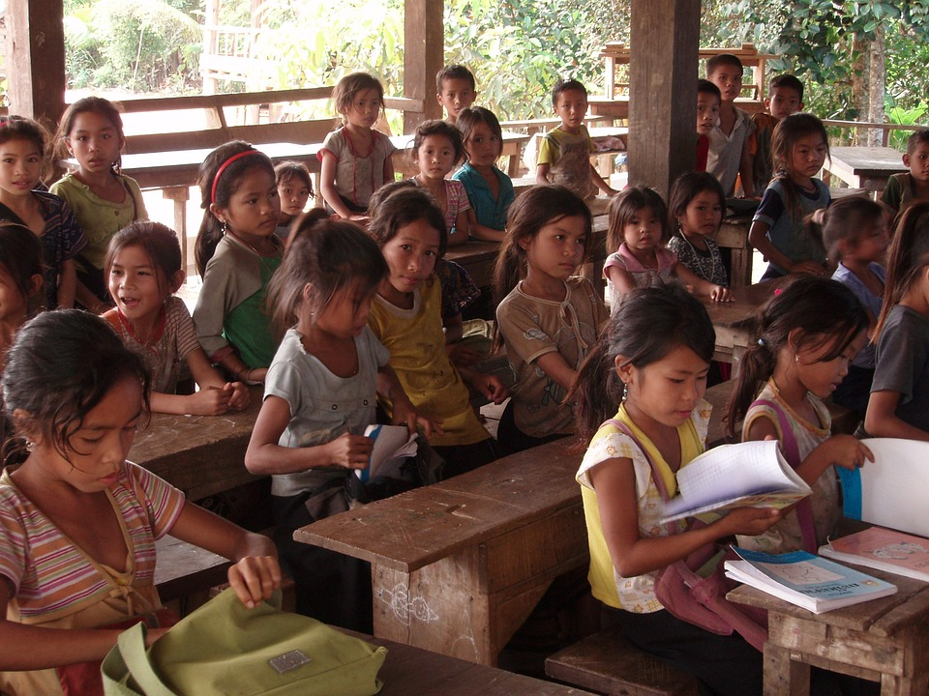
Know Why You Care About PTA
Develop Your Own Value Message
Share your why
Notes:
Now that we know our why, let’s write a Value Message or Elevator Speech, so that we can share our why and help others understand the value of and need for PTA.
Here are some points to consider:
PTA funds essential educational and curriculum needs
PTA advocates on behalf of children and educators at local, state, and national levels
PTA builds inclusive school community for all families
Membership creates a greater voice on important issues and stronger school community
Membership lends time, talent, and treasure to support every child’s potential
[See National PTA How to Create Your Own Value Message Resource]

Slide 5
Learning Objectives
Design a plan to increase your PTA membership.
Explore the tools available to help you.
Share best practices.
Notes:
We’ve established our WHY and have developed our Value Message. Now, we will move forward with an interactive session to teach you a new approach to designing your membership plan. We will:
Define the value and importance of PTA.
Design a plan to increase your PTA membership.
Explore the tools available to help you.
Share best practices.
[CLICK TO NEXT SLIDE]

Slide 6

Importance of PTA Membership
PTA Membership
equals
Influence in Advocacy
This Photo by Unknown Author is licensed under CC BY-SA
Notes:
PTA is an advocacy association. That’s what separates us from all other parent groups … PTA membership directly correlates with our influence in advocating for our children. The greater our membership numbers, the greater voice we have and the greater influence we have on legislation that impacts our children.
This is an important message to convey about the value of PTA membership.
PTA believes we can make every child’s potential a reality. But we need more believers. Your support amplifies our powerful influence. We advocate on behalf of all children in public schools and in public policies. The more members we have – the stronger PTA’s voice. The stronger our voice – the more likely we are to make every child’s potential a reality. Show you believe in our children’s future today. Join PTA.

Slide 7
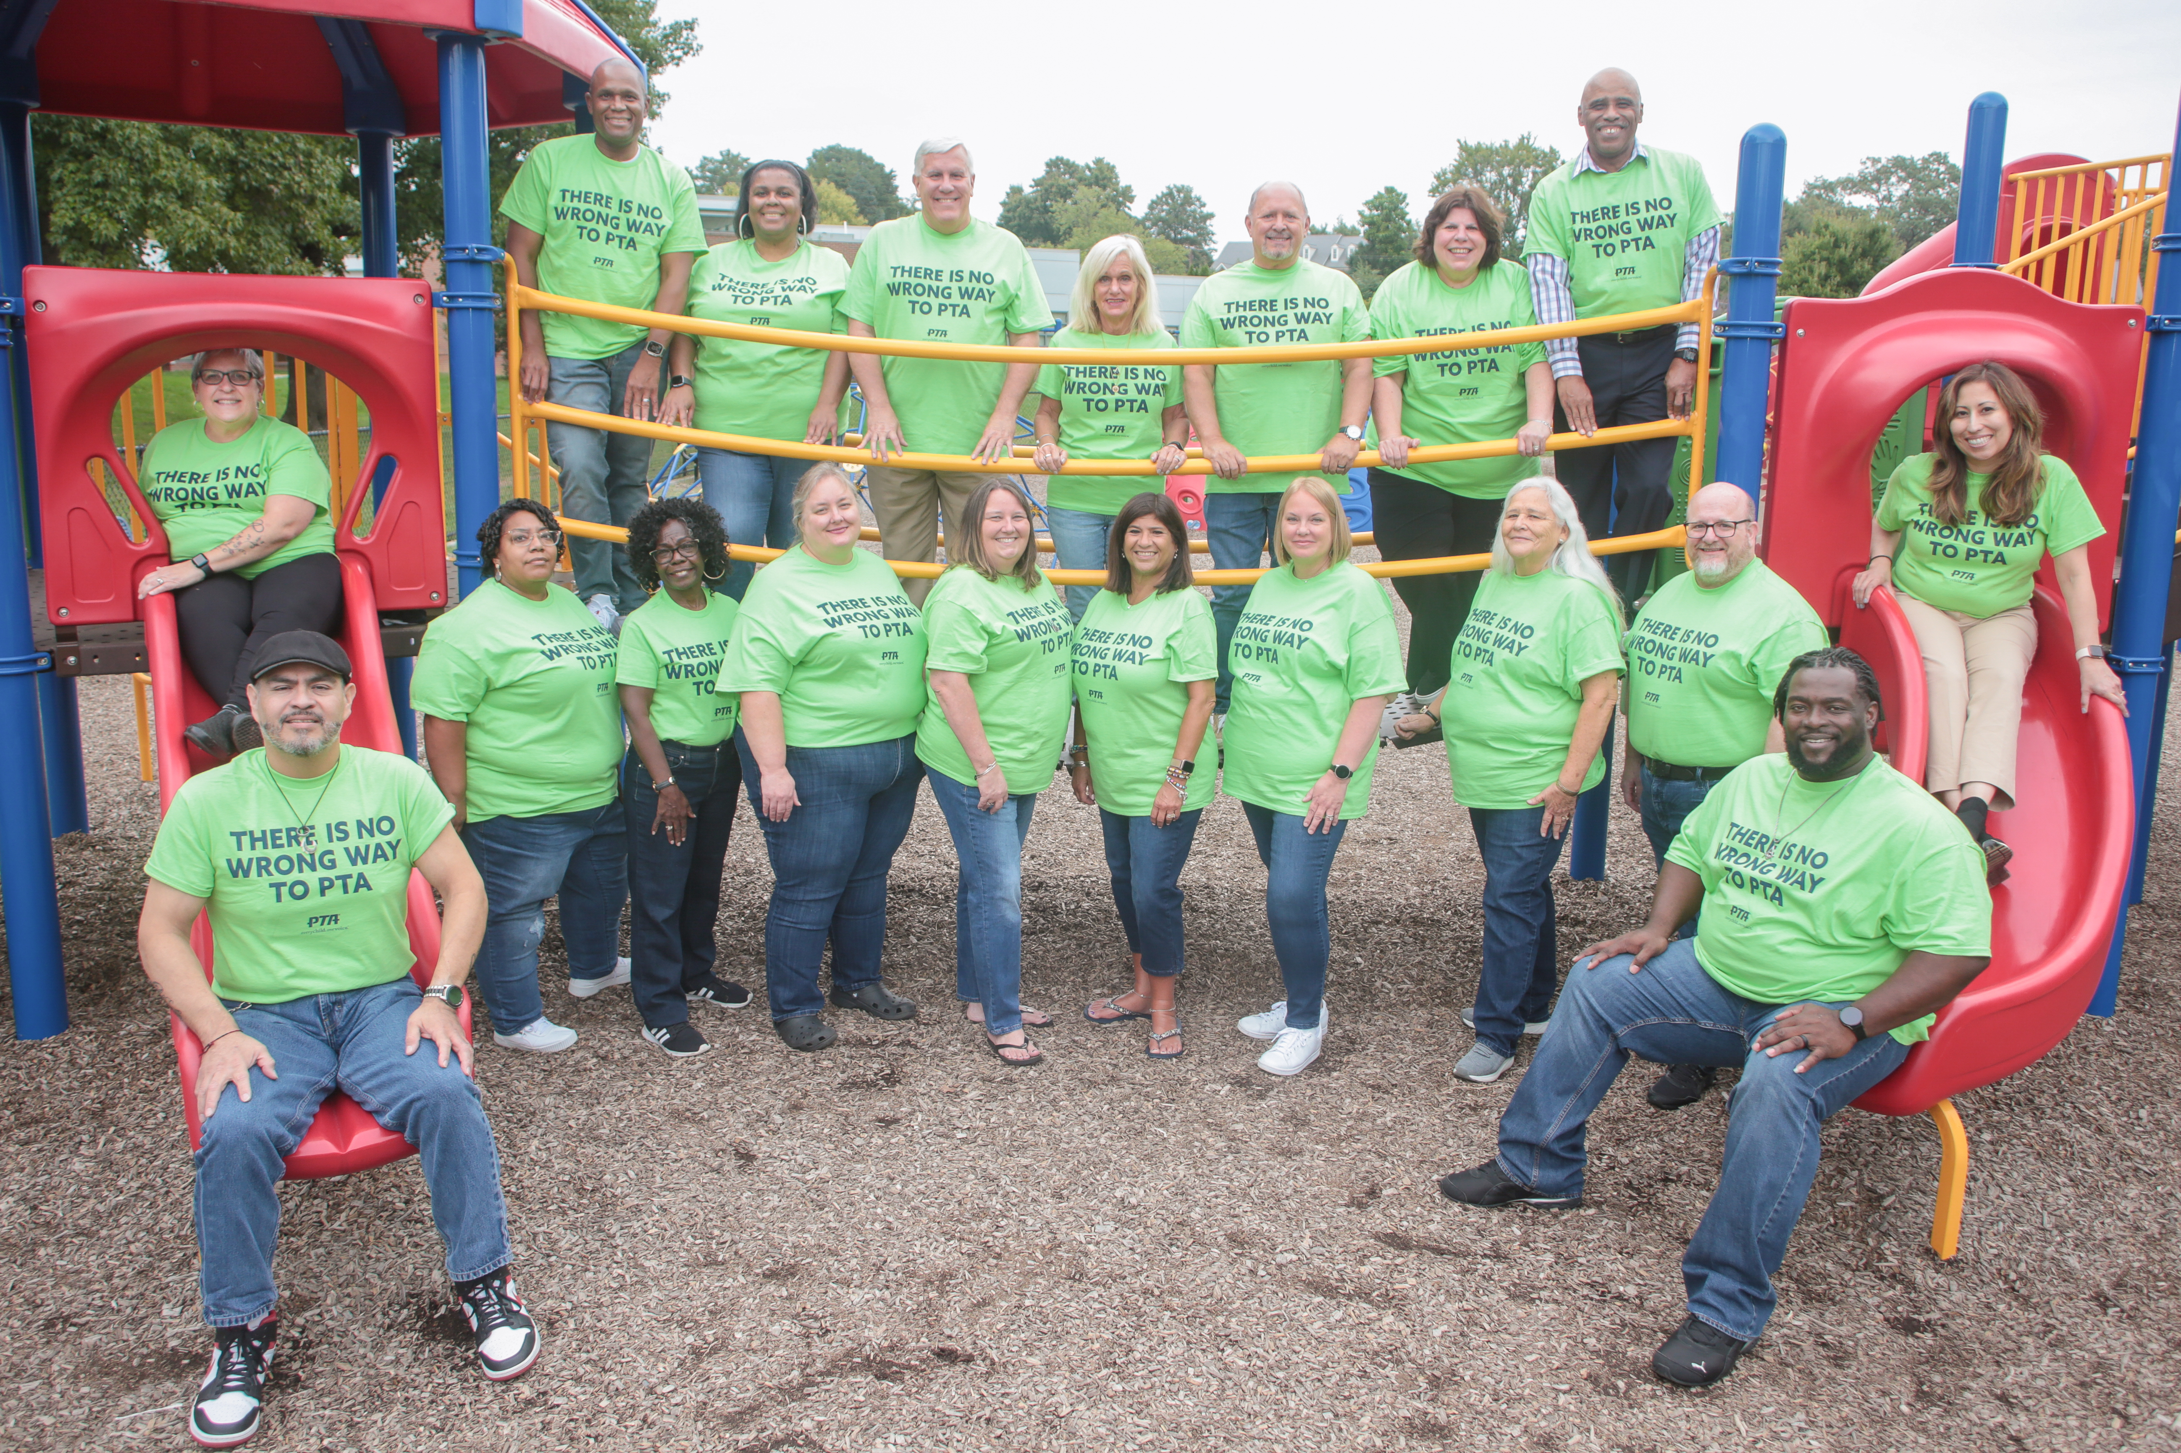
Who is on Your Membership Team?
Every PTA/PTSA Board Member
is part of your Membership
Planning & Recruitment Team
Notes:
Yvonne-
It’s tempting to assign the duties of membership to one or two people. But it’s not a 1-2-person job. It’s everyone’s responsibility.
Why do you think that we say that?
Membership is a relationship, not a transaction. We are nothing without members. We are a set of collective voices speaking up for every child in our nation and beyond.
There is a web of relationships in a school/community and no one person is the holder of all. Can anyone share some of the connections?
By growing membership, you are growing the web of influence your PTA has – and the power of your voices to achieve change for kids.

Slide 8
DIY Membership P.L.A.N.
Picture who, what, where
Listen to what matters most
Ask by aligning efforts to what matters most
Nurture relationships year-round
Notes:
Yvonne
DIY Membership P.L.A.N.
We like to say that PTA is a verb:
An action plan working to support children’s success
An invitation – we can do more together than apart
Encourage them to open their DIY Planning Guide (open DIY Planning Guide on the screen and go through a few pages – can be found at https://www.pta.org/local-leader-kit/membership/developing-a-plan/diy-kit-for-membership-growth)
Share each step of the design-it-yourself membership plan
Picture who, what, where
Listen to what matters most
Ask by aligning efforts to what matters most
Nurture relationships year-round
Encourage each person to start planning as we discuss

Slide 9
LET’S P.L.A.N. - Picture Who, Where, How?
Who are possible members?
Where is it best to reach and connect with them?
How can we attract and renew more members?
Notes:
Who are possible members? - Our PTA membership should represent the diversity of our communities. Be intentional in learning the demographics of your school community and reaching out to include all. Diversity extends beyond race and ethnicity. Be sure to consider possible members from all genders, age groups, community leaders, etc. Invite your elected officials!
Anyone can PTA!
Where is it best to reach and connect with them? – think deeper inside your school community to include faith-based and social organizations.
How can we attract and renew more members? - One of the best ways to attract new members is to ensure that all of your communications reflect the diversity in your community. When one sees themselves in your outreach, they feel included.

Slide 10
Set a Stretch, But Achievable Goal
GOAL = MEMBERSHIP GROWTH POTENTIAL
Potential Relationships | Total # People | Target # or % of Total | 2024-2025 Goal
Teachers/Staff
Students
Parents & Caregivers
Other Supporters
MEMBERSHIP TOTALS
If you desire substantial growth:
Use Membership Growth Potential
Notes:
Now that you have identified WHO, think about setting a goal
If you want substantial growth – think about your potential to grow!
Consider total numbers of:
Teachers/staff
Students enrolled
Parent/caregiver per student (or aim for 2!)
Other supporters?
Set a target # or % of totals to determine your goal
Think about who you know who could help you achieve those goals and start mapping out your web of relationships
Then promote the goal – use the thermometer poster as one tool

Slide 11
Set a Stretch, But Achievable Goal
2023-2024 Members + Desired Increase = GOAL
Relationship Type | 2023-24 Members | # or % Increase | 2024-25 Goal
Teachers/Staff
Parents/Caregivers
Students
Other Supporters
MEMBERSHIP TOTALS
If you desire incremental growth:
Use Prior
Year(s) Trends
Notes:
If you want incremental growth – use prior year trends
Consider the breakdown of last year’s membership – do you know those numbers?
Then determine where you have the greatest potential for growth. Examples: You may want to emphasize dads joining – or grandparents – or students who want to earn community service hours
Determine a stretch goal for increasing each relationship type – then add it all up to get your goal
Use the thermometer poster (perhaps a virtual dashboard on webpage or social media channel) and promote your goal

Slide 12
LET’S P.L.A.N. - Listen to What Matters Most
How will you listen?
What will you ask?
How will you align your priorities to what you hear matters most?
Notes:
Step 2: Listen to what matters most
How do you get feedback? (Kit contains several suggestions.) In this current virtual world, you will need to explore ways to get feedback virtually (i.e. polls or surveys)
What will you ask? (Kit contains several suggestions.)
Explain that what you hear defines what you need to do to FOCUS on what matters most…which is next step
Use flip chart (or virtual flip chart and breakout rooms in virtual meeting) to generate ideas
Always be a good listener. Listen to learn rather than listening to respond.
Visit ptakit.org ( you must be logged in to access this)

Slide 13

LET’S P.L.A.N. - ASK & ALIGN
Ask by aligning your message to what matters most!
Thanks to your feedback, our PTA/PTSA will focus on:
1-2 SPECIFIC OBJECTIVES HERE
Your membership support will help to:
2-3 DESIRED OUTCOMES
Notes:
Step 3: Ask & Align
CHALLENGE QUESTION:
What’s the best way to start a membership conversation with someone? What would your ask be?
Use flip chart (of virtual use break out rooms, whiteboard or annotate feature) to generate ideas
Answer: by LISTENING. Ask a prospect question, like “What do you think PTA could do to improve the school for our students?” (Or whatever level, if you’re on a council, district, region, or state level.)
You will probably hear what resonated most with parents. Probe until you hear something that directly connects with your focus areas. Then, align your answer.
Start with, “You’re not alone – a lot of parents have told us that. That’s why…”
Include 1-2 PTA mission objectives and 2-3 desired outcomes
Let’s play that out.
Take a few minutes to work together and craft an ASK that shows your PTA is listening and aligning your efforts. Include 1-2 PTA mission objectives and 2-3 desired outcomes.
Ask 1-2 to share what they heard and how they aligned efforts to reflect what matters most to their PTA school and community.
If time, move on to scenario 2. Or, have some tables focus on scenario 1 and others focus on scenario 2.
This two-way conversation is the difference when you think of membership as a relationship versus a transaction. In a transaction, you’re merely asking them to join – to complete a process. Not to be part of supporting a cause they care about.

Slide 14

LET’S P.L.A.N. - ASK & ALIGN
How will you respond?
I don’t have time.
I don’t like to fundraise.
My wife joined.
What else do you hear?
Notes:
How Do You Respond to Frequent Nos?
Facilitate conversation about each answer (if virtual, put up a poll with the choices below)
I don’t have time. No time is needed, ask question to get you to align your message to what they care about.
I don’t like fundraising. You don’t have to fundraise. Ask question to get you to a place in the conversation where you can align your message to what they care about most.
My wife joined. Dads are so important and care just as much as moms about school improvements. What do you think PTA should be focusing on in that area? …Your support will help us to …
Do you just want my money?
What do I get from my investment?
How does it effect my child?
What else?
Remember to always have your elevator speech handy- Why PTA?

Slide 15
LET’S P.L.A.N. - NURTURE
How do you nurture relationships?
  Be transparent with spending and budget
  Welcome all skills, talents and concerns
  Incorporate PTA branding
  Use social media and brief, frequent messages
  Respect time
  Show you care
Notes:
Step 4: NURTURE
Like Any Relationship – It Takes 2-Way Effective Communication
National PTA’s market research fueled these bullets – this is what parents nationwide said they wanted from PTA:
They want transparency with spending and budget.
They want to know what impact you are making and see you brand. Toot your own horn!
They want quick, mobile messages.
They want to feel included and welcomed to contribute – but not pressured.
When they do show up, they want it to value their time and to focus on what they’ve said matters most.

Slide 16
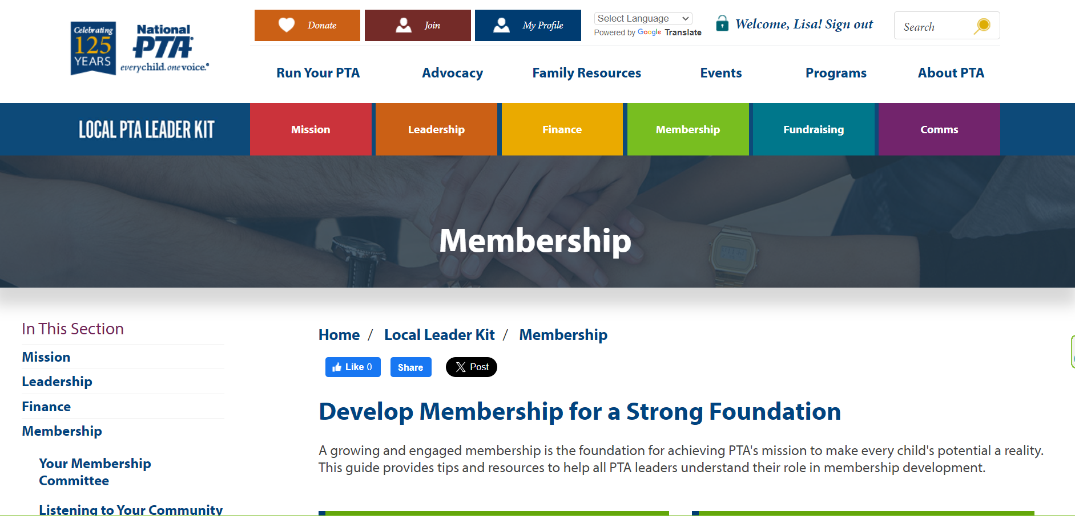
More Tips & Tools
Notes:
Yvonne
Now let’s explore the website. Bring up the the PTA Kit at https://www.pta.org/local-leader-kit/membership.
Show resources on website. Have to log in to access.

Slide 17
Thank you for amplifying the
voice & power
of PTA!
Notes:
With the time that remains, let’s talk.
What are your ideas to grow membership? Please share
Express gratitude when time runs out.

